Slide 1



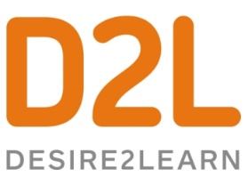





Event Sourcing
Or, How I Learned to Stop Layering And Love the Event Log
Notes:
Shout out to our great sponsors that make this event possible

Slide 2
Chad Hurd
@CaffGeek

Slide 3

Event Sourcing
Or, How I Learned to Stop Layering And Love the Event Log
Is your application in the gutter? Spare yourself the grief, and strike out using Event Sourcing.
Come on....don't be a turkey
-- Adam Rehill
Notes:
Synopsis
Wondering what Event Sourcing is? How is this approach different from the way we normally write applications? Is adding a message bus enough to call what you're doing Event Sourcing? Over the past several years I have developed an app leveraging Event Sourcing for the Master Bowlers Association Nationals, and have learned some of the associated pros and cons of seeing ES in action. Using this app as a case study, we're going to answer some questions about ES; What challenges can it solve; What challenges can it cause; What did I do well... and where did I go wrong.

Slide 4
Our Journey
The Problem
A Familiar Story
The Solution
Some Code
Wrapping Up

Slide 5
Part 1
The Problem

Slide 6

Notes:
Travel back to 2006

Slide 7

Notes:
This isn’t an app to track your score through a game
This tracks the tournament results as games are completed
In the past nightly PDFs...nobody could follow the tournament results game by game
Wanted friends/family of competitors to be able to track how they were doing throughout the tournament
I did this because *I* wanted something better than what we had in the past, MB was hosting

Slide 8
Data Coming In
8 Provinces competing
5 Team Divisions
5 people per team + coach
5 Singles Divisions
21 games
Over 4 days
Totals 5040 individual game scores
Names
Averages
Room Assignments
Travel Information
Practice Schedule
Guests
Profiles
Lane Draws
Hotel
Bowling Centres
Sponsors
etc
Notes:
This is about managing the entire tournament, from including preparation, through to the final banquet
About 13,000 writes of data into the system.

Slide 9
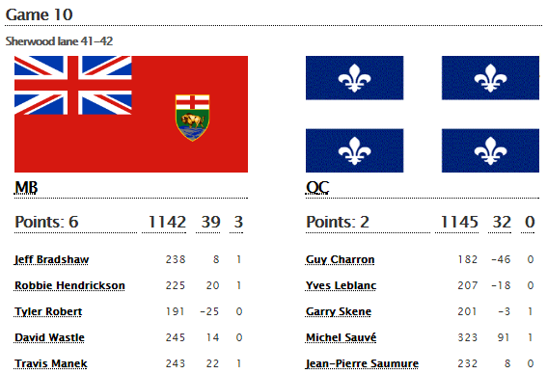
Data Going Out
Notes:
Looking at a single match

Slide 10
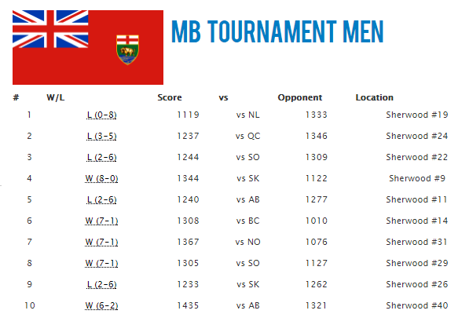
Data Going Out
Notes:
Looking at a single match

Slide 11
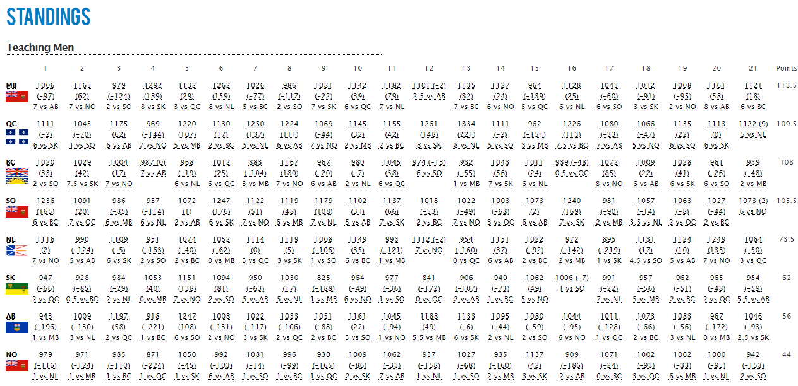
Data Going Out
Notes:
One division’s results… there are literally 100s of calculations happening,
half a dozen tables,
Rolling up ~1000 individual games into the final standings
...every single time the page is loaded

Slide 12

Notes:
2006 … We got shutdown

Slide 13
Notes:
The second time, was the worst possible moment, the tournament was over, and we were trying to generate and print the stats packages
I had implemented caching, but the host was unreliable, and my caching was storing error pages, so I had turned it off
Other customers on the shared host were complaining their site was slow…
Had to beg to get access to the database so I could run it locally to generate results
In 2006 a dedicated server wasn’t cheap...and we were in the middle of the event...we couldn’t migrate over (this wasn’t azure)

Slide 14
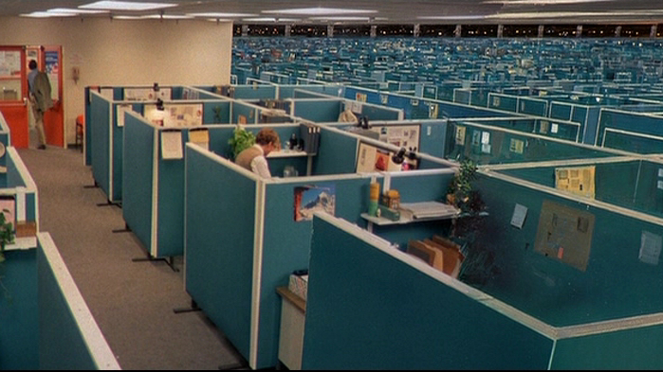

Notes:
Soo I got to thinking…
How can I build this without redoing all those calculations
Caching was unreliable…
Denormalizing state has risks that something gets missed and out of sync between tables

Slide 15
Part 2
A Familiar Story

Slide 16

Notes:
New project, you’re standing, staring a clean slate, you’re going to design perfection, this time, this time you’ll get it right.

Slide 17

Notes:
You’re smarter now

Slide 18

Notes:
You get to work…

Slide 19
Notes:
Time passes…
And what happens?
Changes to requirements, developers come and go, and …

Slide 20
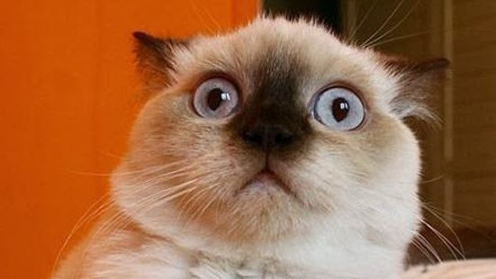
Notes:
What just happened?

Slide 21
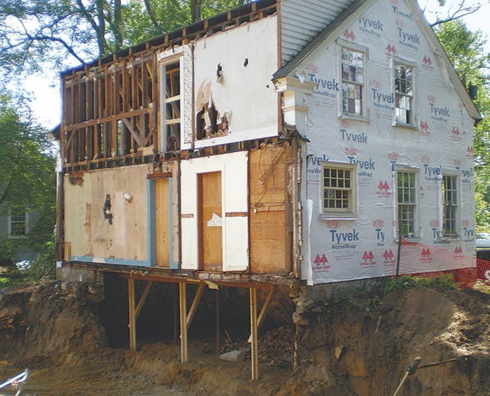
Notes:
We’ve done it again!
The foundation is suspect
There are doors, with no access
Odd pieces have been added on, and half finished
Pieces have clearly just been ripped off, with no care
Someone put in some new windows, yet didn’t finish the wall around them
Wires are dangling
It’s a mess...

Slide 22
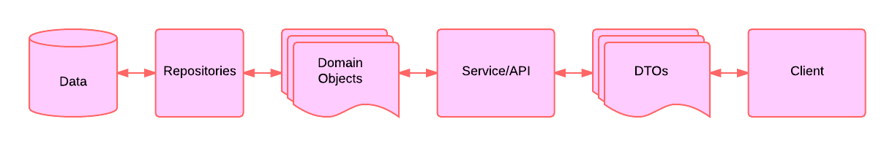
The Layered Approach
Notes:
Very linear pattern
Reads and writes going in both directions
Our layers and entities are trying to handle traffic in both directions…
It does neither well
Database optimizing for writing
DTOs are often the exact same objects for reads as they are for writes, same as our Domain Objects

Slide 23
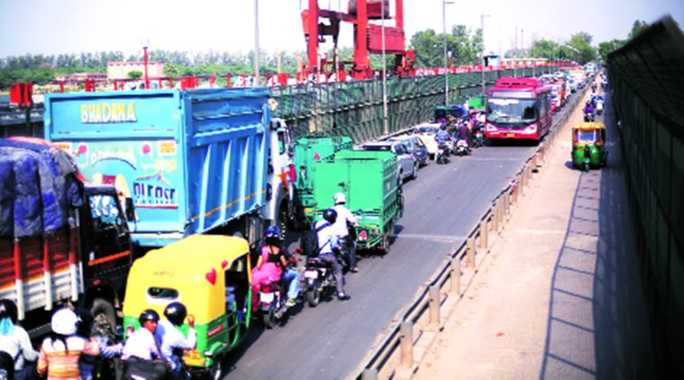
Notes:
Our app is sort of a traffic jam, it’s trying to support information flowing in two directions, and it’s good at neither

Slide 24

Notes:
Take a moment…
Tradeoffs...I’m talking about building a system optimized for reading
That’s not always what we’re trying to build
This is not a replacement for everything, it’s just another tool.

Slide 25
Tradeoffs
Models are often used for both reading & writing
We lost the context of why the change happened
We can’t look into the past
Scaling our app
Notes:
Also the same code is used to edit a person’s name as is used for their address...when you want a name, you often get back a lot of extra data that you didn’t need and then you spend time mapping it
If they aren’t...you’re already starting down CQRS...and what I’m talking about...
An update is an update...why did they change their name? (typo, marriage, wanted to)
If marriage...maybe other parts of our system care about that...trigger checking their benefits/deducted taxes/etc?
Yes we can add auditing...but that only works for things we thought of auditing or logging going forward
This is the problem I faced...as built, my only real option was more hardware, which was too costly

Slide 26

Why?
domainModel.Name = dto.Name;
domainModel.Age = dto.Age;
domainModel.Gender = dto.Gender;
domainModel.Address = dto.Address;
domainModel.City = dto.City;
domainModel.Province = dto.Province;
Notes:
That’s not to say mapping isn’t needed between points outside your applications sphere of influence, but if your app is the only accessing the database (as it should be)…
”then maybe...yagni”
This is a waste of money, especially in the cloud where you pay for compute cycles.
No logic here...just cycles
Maybe you use automapper?
But is it REALLY worth it? If I change my model, typically we spend time making the same change in the DTOs…and which ones should I make that change on? It’s really dependant on each use case, but often, we don’t recreate our DTOs for each specific use case...there is often a lot of sharing, or worse, inheritance and when we modify that DTO, every UI element that uses it gets that change...even if they don’t care about it. There’s a lot of overlap, and poor SOC...despite our best efforts.

Slide 27

Notes:
Our app only stores it’s current state
It’s a single frame of an ever changing movie
But we’ve lost context
We then need to bolt on an extra system for logging and auditing… (remember our house earlier...that’s how we got there)

Slide 28

Notes:
The business has a question...
Why did this change?
When did this change?
What was the value before?
How many people that add X to the cart, actually buy it?
...does your normalized db reflect any of this? Not yet...you can add audit tables, or logs, but they only start working now...they don’t let you see the past.

Slide 29

Notes:
Scaling is difficult…
Run multiple instances of the app (read and write side)
Wasteful if it’s just a some points that’s are bottlenecks.
Multiple databases?
Locks when 2 systems try to write?
Which system wins if they both change the same record?
We need to rearchitect. A rewrite...but...wasn’t that what we *just* did and yet here we are again?

Slide 30
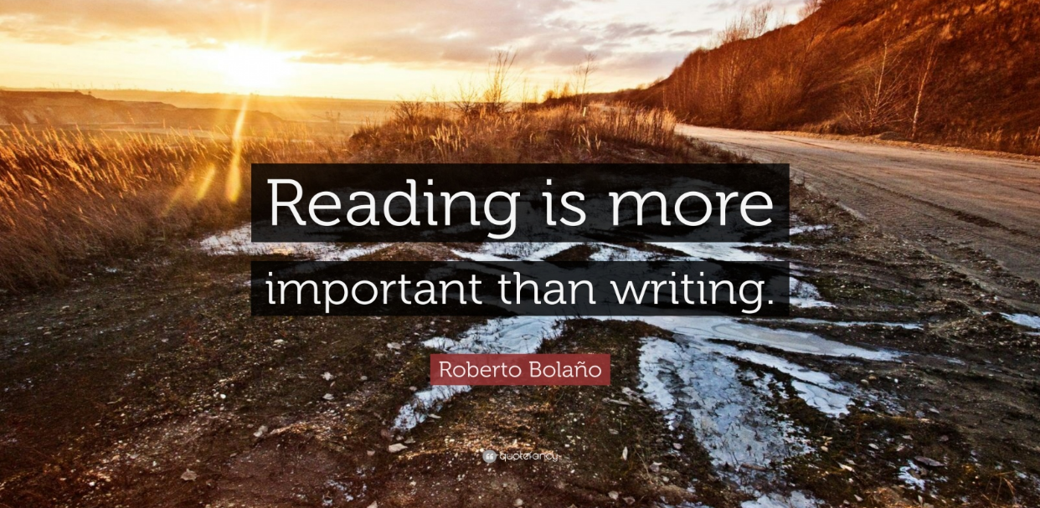
Notes:
10 : 1 reads to writes on average

Slide 31

Notes:
Reading and writing are different!!!
They are different concerns
We don’t all share one copy of a book. We write once, and make copies so reading can be done in parallel
Could you imagine if we all had to share the same book...
Normalization of databases optimizes for writing, no duplication of data, write once, reads become SLOOOW with many joins of tables, searches, etc…
Why for 80% of our use cases, are we going through all this effort that slows down our app.
We’ve optimized for the 20% case...which ironically, is the use case people are willing to wait for.
If saves are too fast, people...get worried it didn’t actually save.

Slide 32
Sum Up
Read vs Write
Capturing Why
The Past
Scaling
Read != Writing
Tradeoffs

Slide 33
Part 3
The Solution

Slide 34
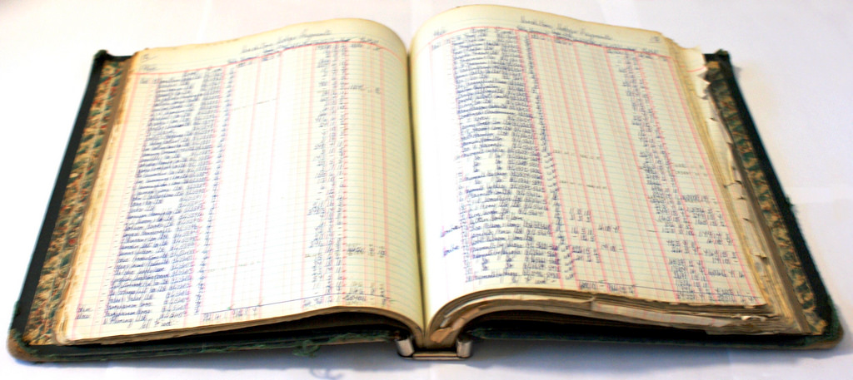
Notes:
This isn’t new...event sourcing
Accountants understand the value of never destroying data.
They practice immutability every single day...mistakes in data are fixed with MORE data.
They are time travellers...able to answer questions and analyze “WHY” things happen...not just see outcomes...they can forecast

Slide 35
Key Terms
Commands
Events
Command Handlers
Aggregates
Read Models (Event Handlers)
Notes:
Commands are issued to be applied to an aggregate POCO
Events are outcomes/facts
Command Handlers attempt to execute a command
They load all the prior events on the aggregate to get it’s current state (this is surprisingly fast)
They then attempt to execute the command on the aggregate
The outcome of this is a stream of event(s) and possibly, more commands (like send an email)
Read Models VERY DENORMALIZED and subscribe to events they care about to update their current state
High scores
Standings
Teams win/loss page
Individual's page

Slide 36
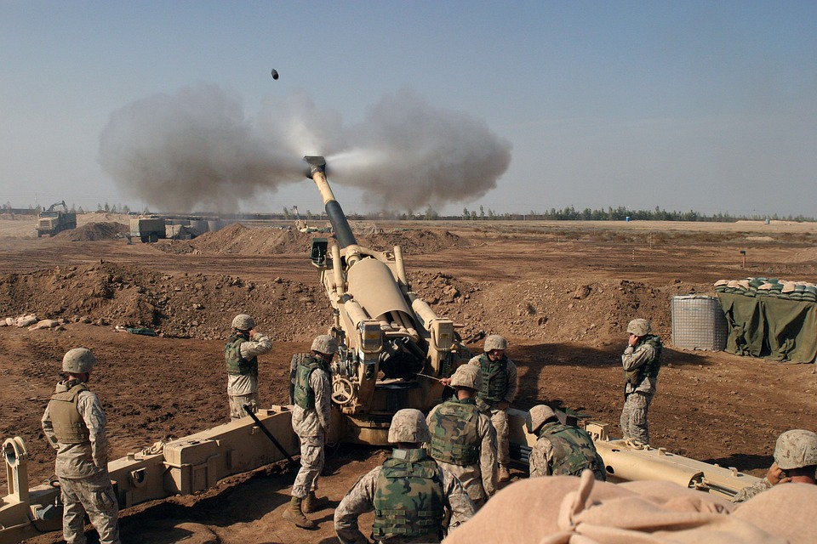
Notes:
Command to fire at a target was issued by ...someone probably not in the picture
Those soldiers, they're your command handlers, they can still choose not to obey, or to fire at a different target I guess
We see they fired...so that's one event, the gun fired (could have failed...)
More events are about to happen...and these command handlers will report them
- Direct hit
- Miss
- Maybe they issue another fire command as a result...
This group...that's your aggregate, they're a unit, identifiable...it's made up of a few different parts
You have people who care about the results of this command, your read models, who want to know what the events coming from it are (press, chain of command, etc) and they’ll use those events to generate a report/article/whatever

Slide 37
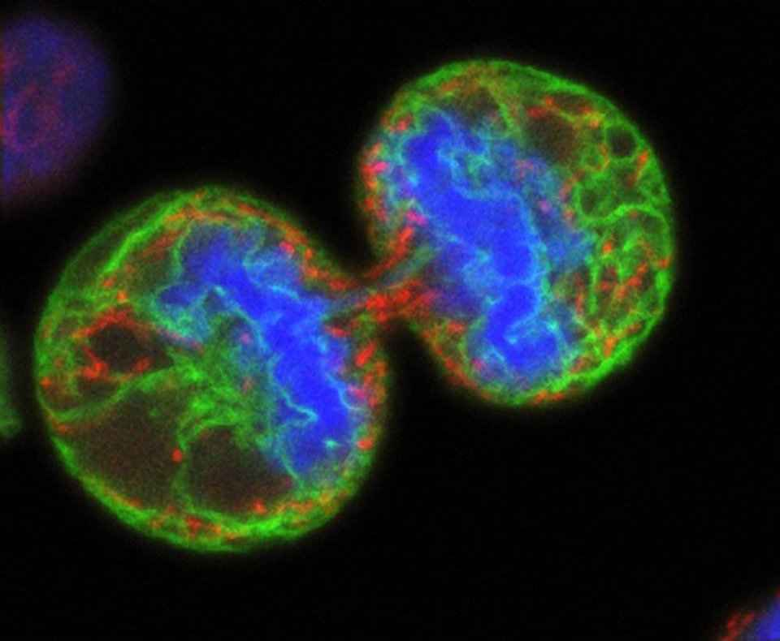
Notes:
So we split our system into two (1 read system, 1 write system)
One half consumes commands producing events (and maybe more commands) - Write/Command side
The other half consumes these events - Read/Query side
This is CQRS - we just happen to be talking about one specific method of that, Event Sourcing

Slide 38
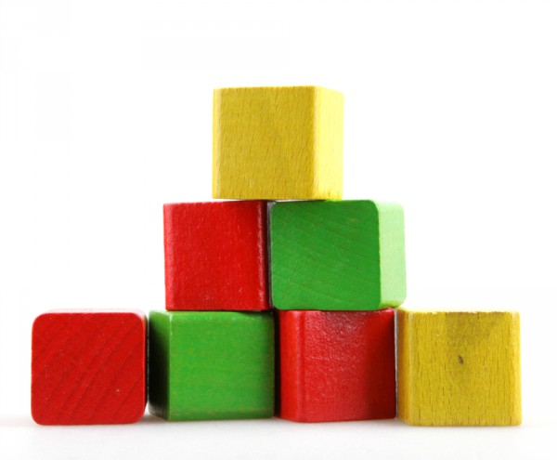
What Do We Need To Build This
Command Handlers
Event Storage
Event Handlers
Read Model Storage
Orchestration
Notes:
Read models...because we have an event log...which is our source of truth...we can delete our read model storage and regenerate it from the event log
I’ve done it countless times (replay 35,000 events in 17 seconds) that deletes and rebuilds
every read model (15), every calculation, every event on D1 Shared ($11/mo)
3 times I completely rewrote the storage medium for the read models (document file format that scaled horribly -> azure tables -> azure blobs)

Slide 39
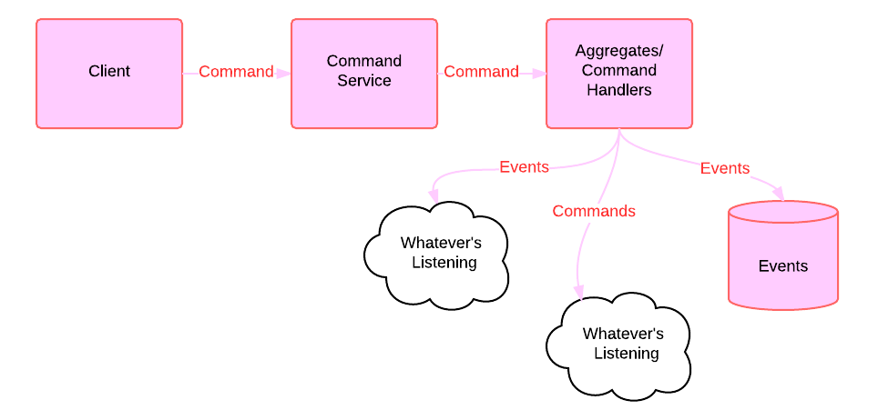
The Write Side
Notes:
Command service is just a simple api, everything is done in the Command Handlers
Validate
Reject the command if it’s deemed invalid for some reason
Business rules
Raise event(s) or more Command(s)
Events should not raise commands
Because then rerunning events will result in new commands, and that would be bad…
For example, if an event triggers an email
Instead have a command for sending email, and write the result to the event stream
OnEmailSent

Slide 40
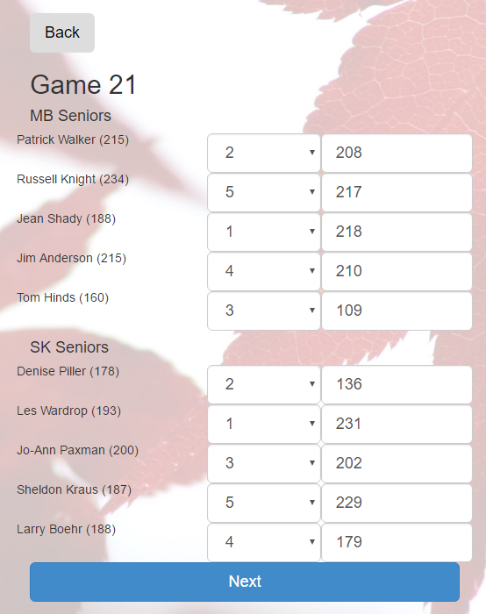
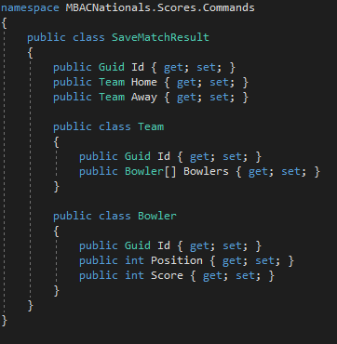
Data Coming In
Notes:
Looking at a single match

Slide 41
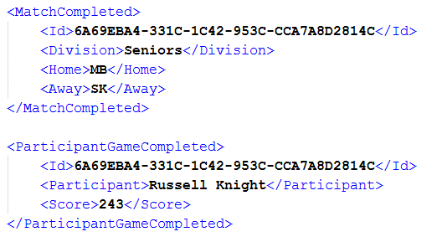
Resulting Events
Notes:
After the command handler runs, events are returned
What those events are is kind of up to the system
There would be several of these ParticipantGameCompleted events (10) in this case

Slide 42
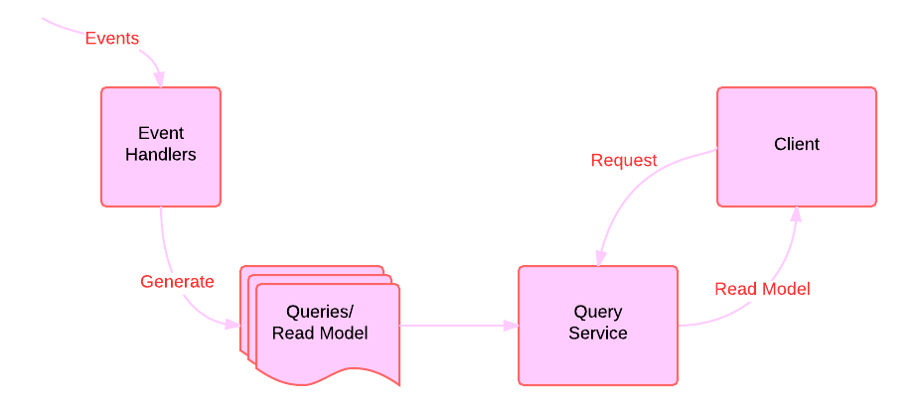
The Read Side
Notes:
Event sourcing is very fast
Read Models are generated BEFORE the client requests them
You could have several duplicates of this service, each with it’s own duplicate datastore of read models
They all subscribe to the same events
They will be eventually consistent, but not necessarily consistent at a given point in time
They just need to be found and returned, no joins, no complex db lookups, just quickly retrieve and return prepared data

Slide 43
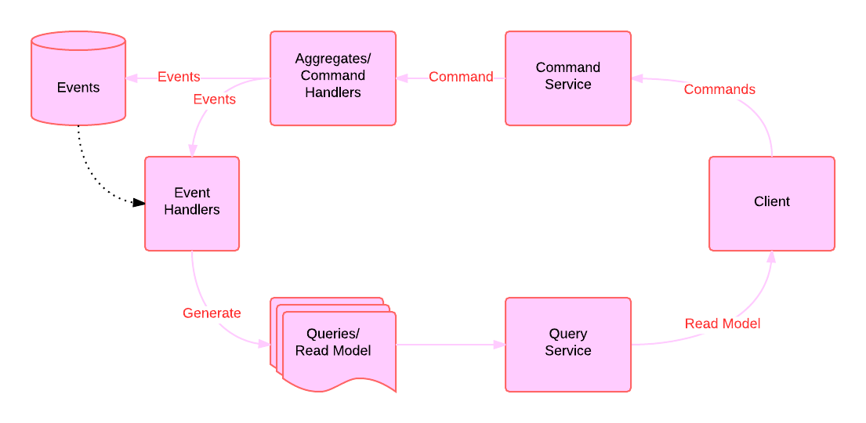
Event Sourcing
Notes:
Slow down…
Data flows in one direction
Talk about each component walking around this slide...
Events are a history of everything that’s happened
can delete and regenerate all our views
bugs can be fixed IN THE PAST!
Read models are VERY VERY denormalized

Slide 44
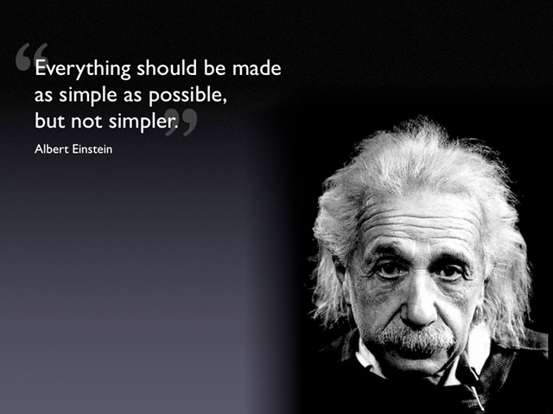
Notes:
This is a great quote...and that’s what we’re doing, each of our components does one thing...it handles data in one direction, for a single purpose.

Slide 45
...what he actually said was
“It can scarcely be denied that the supreme goal of all theory is to make the irreducible basic elements as simple and as few as possible without having to surrender the adequate representation of a single datum of experience.”
Notes:
The problem...that’s not what he said...

Slide 46
Part 4
Some Code
Notes:
Let’s talk about what each of these components do, to build that solution...

Slide 47
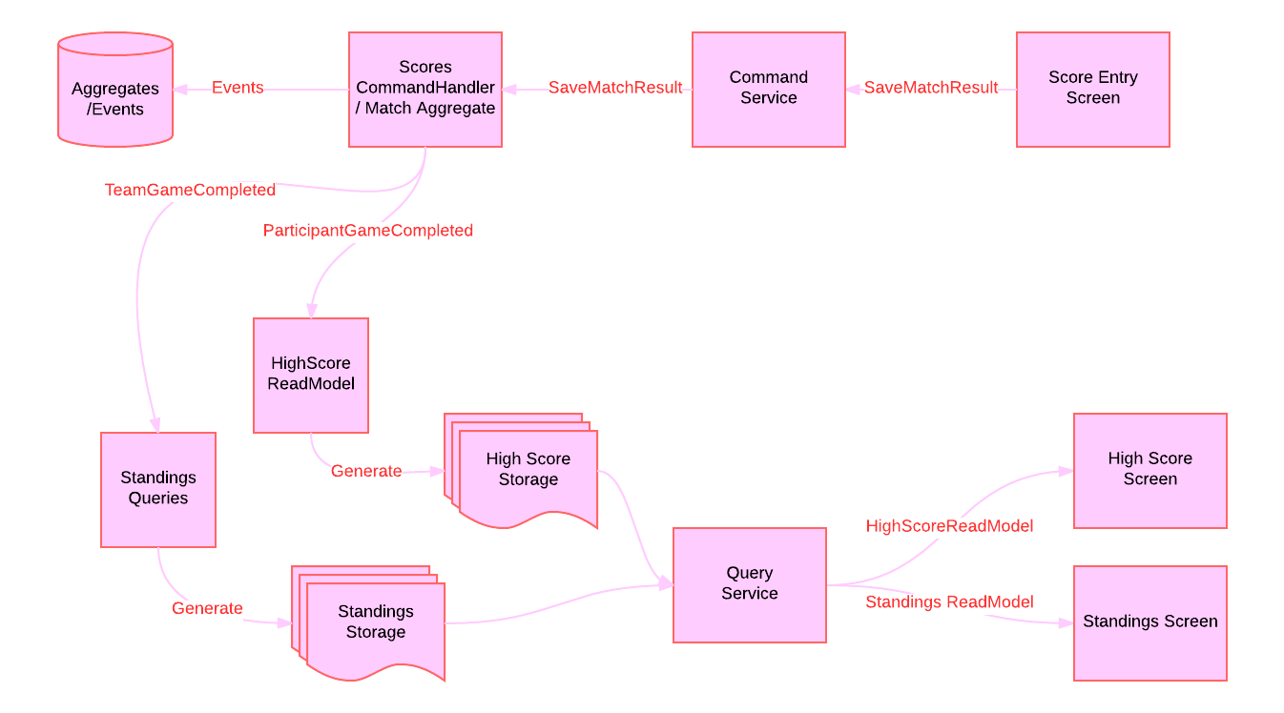
Entering a Score
Notes:
The boxes on the right, are our UI
The Command and Query Service are simply our API in/out of the system
Top Left is our Aggregates, and Event Stream...our truth
The command handler takes the command to save the match result, and generates various events, two of which are shown...handled by different read models (which have also consumed other events prior)
They update their state with these new events, and generate and store that state, which the Query service can pick up when the user requests high scores, or standings.

Slide 48
We enter the scores, issuing a command
Notes:
Looking at a single match

Slide 49
Processing the command
Notes:
What is the purpose of a command handler…
To attempt to execute the command, and report the result of that attempt by returning events

Slide 50
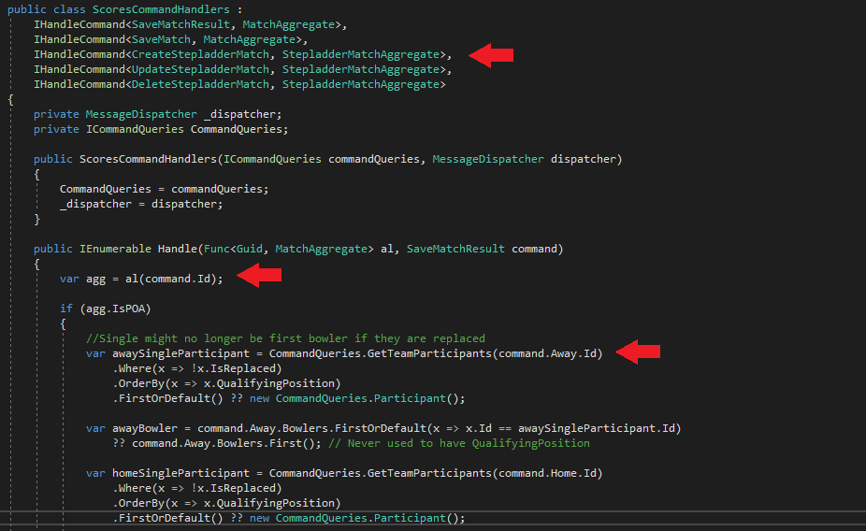
Notes:
We first rehydrate the aggregate `var agg = al(command.id)` with all its prior events
Then we perform our business logic to validate and process the command
CommandQueries … this is possibly a mistake, I got my domain model wrong...DDD

Slide 51
Resulting Events
Notes:
After the command handler runs, events are returned
What those events are is kind of up to the system
There would be several of these ParticipantGameCompleted events (10) in this case

Slide 52
Store the Events
Notes:
The event stream is now persisted to the database

Slide 53
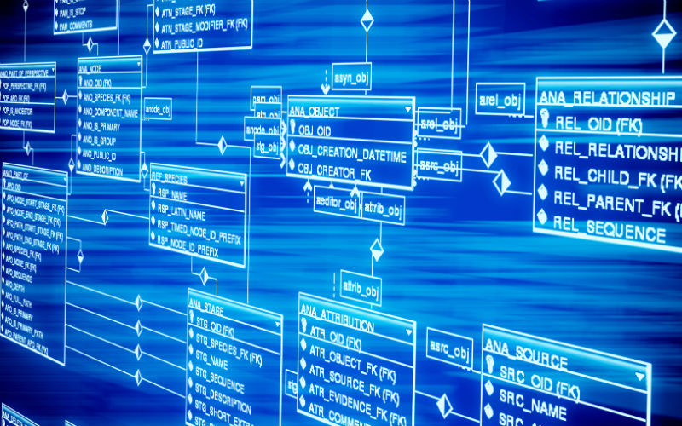
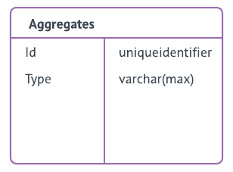
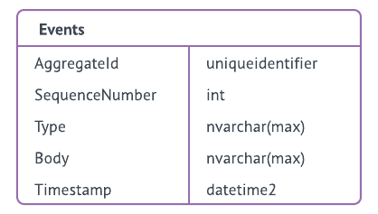
The Event Store
Notes:
Describe the tables (Aggregates are just 2 columns)
Aside from a couple of tables for security, that’s my database...basically a digital version of the ledger from earlier
Aggregates, and the events that have happened upon them
To regenerate an aggregates state, you replay it’s events - this is fast…
Most aggregates have very few events
How many edits happen to a single record in the database?

Slide 54
Building our Read Models
Notes:
Event handlers transform these events into our Read Models

Slide 55
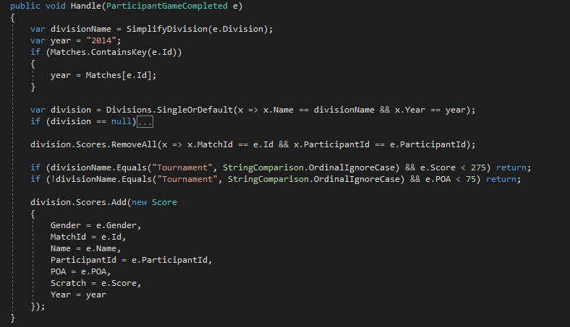
Notes:
HighScoresReadModel
If a score is higher than one of the thresholds
We add the score to that divisions high score list

Slide 56
Persisting the Read Model
Notes:
...you didn’t save it

Slide 57
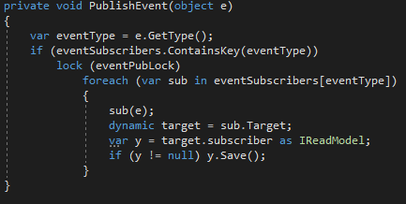
Notes:
How you save is really up to you…
I have each read model implement a save method
After events are published, it saves itself
In this case, I literally just serialize the readmodel
It contains lists of it’s data, and thus can be serialized and deserialized as needed

Slide 58
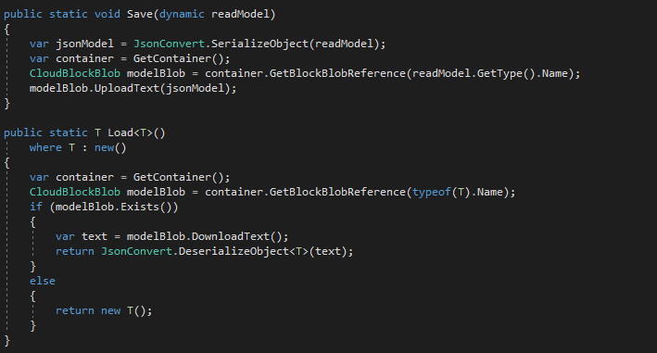
Notes:
Container is a reference to azure blob storage

Slide 59
Querying for data
Notes:
This is just a simple API that can read from the read models, and return the data to the client
Contains security

Slide 60
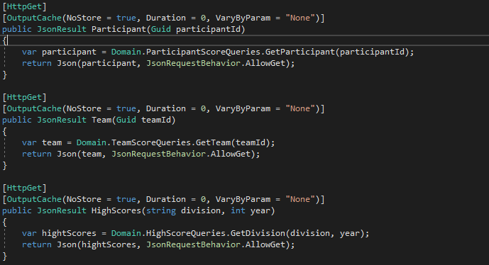

Slide 61
The Read Model is Returned
Notes:
And we’re back...

Slide 62
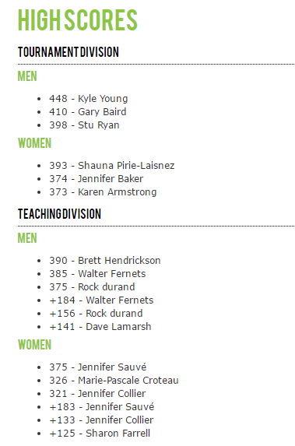
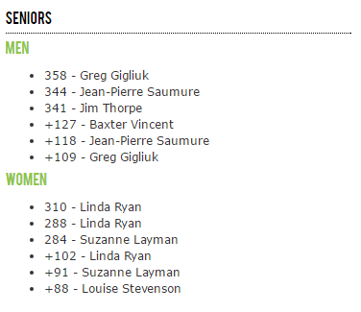
Notes:
We didn’t have to go through over 5000 scores to get this data (and calculate the difference of the score with their average for the high POA scores)
...we already had a much smaller set of high scores in our read model and just needed to return them to the UI to display What is POA

Slide 63
Framework
Message
Dispatcher
Notes:
But...how are the messages moving around…
I’ve been saying they subscribe to them, and publish them...but how...

Slide 64
Notes:
As I said before...we don’t need
Azure Service Bus
Rabbit MQ
ZeroMQ
NServiceBus
I’m doing everything synchronously (per request) and waiting for it to happen.

Slide 65
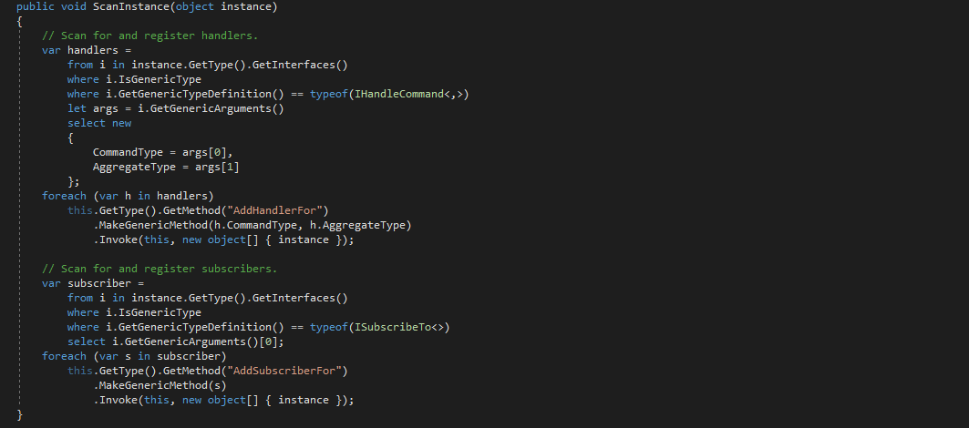
Notes:
Reflection as the app starts up.

Slide 66
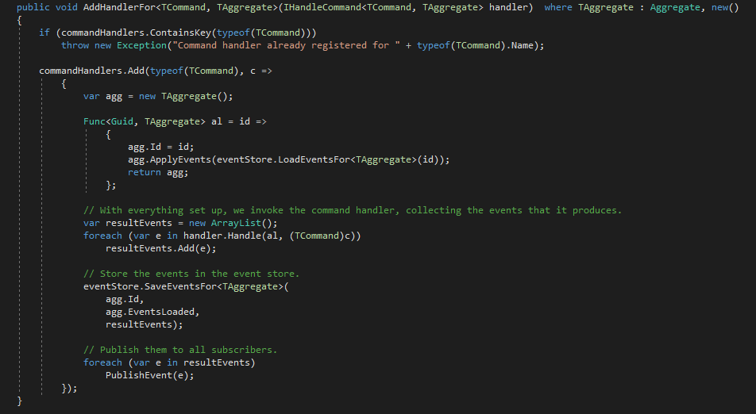
Notes:
ONE command handler per command
We register it in commandHandlers based on the ‘typeof(TCommand)`
When it gets a command, it rehydrates the aggregate by applying all it’s events
Then it handles the command
Saves any resulting events
And publishes them to whatever is listening to them; registered in `AddSubscriberFor`

Slide 67
Framework
Message
Dispatcher
Notes:
We’ve now built all the components of our system
Each does one thing, with a single purpose

Slide 68
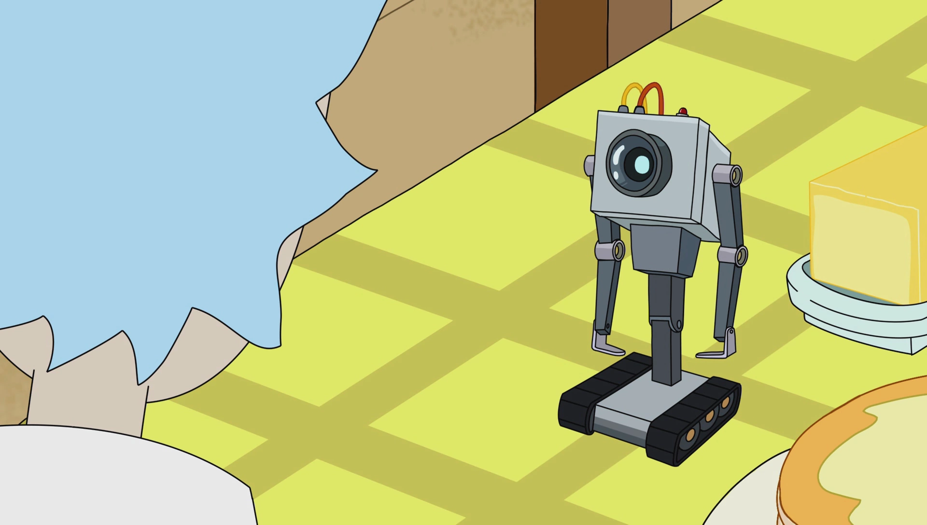
What is my purpose?
You pass the butter
Notes:
Services don’t need to be complicated. Their purpose has little scope.
Thankfully they’re not sentient like this little guy.

Slide 69
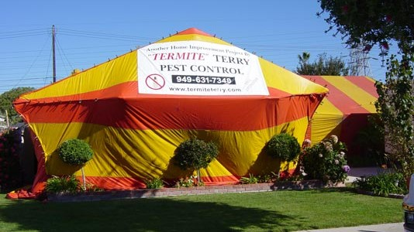
Notes:
Have users across the country
You first look at your list of events...what has happened, does it make sense?
Yes?
Publish them through a local instance of the read model and watch what happens as each event is handled
No need to try and guess why the state is how it is, look at events that your read model uses
It’s easier to differentiate between a bad calculation, and bad data entry, because you can see both

Slide 70
Part 5
Wrapping Up

Slide 71
Disadvantages to Event Sourcing
Event versioning
Large aggregates
Messaging can be complex once you scale
Eventual Consistency can become a problem
Notes:
You didn’t talk about Eventual Consistency or Scaling

Slide 72
Advantages
Event Store is a historical account
View state at any point in time
Read is optimized to be fast
Write is optimized to be correct
Scaling is easier

Slide 73

What I Would Do Differently
My aggregates don’t do much
My aggregates are not correct
CommandQueries are shared
Testing is mostly absent
Notes:
UI - the Angular mix with MVC is horrible
Very little validation in Aggregates, so I’m actually rarely populating them...this is why CRUD isn’t really ideal for CQRS
CommandQueries model...I need to remove that out somehow

Slide 74

What Did I Get Right
No Eventual Consistency
No Message Bus
Rebuilding Read Models
Choosing Event Sourcing
Notes:
Not using async or eventual consistency yet
I’ve been able to change the read model storage 3 times already (some doc storage that was awful -> azure tables -> azure blobs
Using ES...users are across Canada...support is easy when I don’t need to ask “what did you do” and can just look at the events for most issues

Slide 75

What’s Next
Notes:
Snapshots (little need to replay past years) … speed up that 17s regeneration time…
Azure Service Bus
Microservices for read models (F# ?)

Slide 76

Chad Hurd
@CaffGeek
Source: https://github.com/CaffGeek/mbacnationals
Notes:
More Info From: Greg Young / Udi Duhan

